Slide 1
SUPERVISOR LEAVE FLOWCHART

Slide 2

START/END
DATABASE
PROCESS
DECISION
OFF-PAGE REFERENCE
(OUTGOING)
DATA
OFF-PAGE REFERENCE(INCOMING)
PRINTOUT
FLOWLINE

Slide 3
START
USERNAME PASSWORD
LOGIN
N
FORGOT
PASSWORD
?
N
VALID
?
Y
Y
EMAIL
RESET
PASSWORD
A
SUCCESSFUL
?
N
Y

Slide 4

A
MANAGE
LEAVE
?
B
N
APPLY LEAVE
?
N
VIEW
LEAVE
?
N
AMEND
LEAVE
?
N
APPROVE
LEAVE
?
N
DECLINE
LEAVE
?
N
N
SOFT
DELETE
LEAVE
?
CANCEL
LEAVE
?
N
Y
Y
Y
Y
Y
Y
Y
SELECT TYPE
LEAVE
DATES,STATUS,
DEPARTMENT
ENTER
REASON
APPROVE
N
REASON FOR CANCEL
SOFT
DELETE
AMEND
LEAVE
?
ENTER
REASON
APPLY
LEAVE
QUERY
DATA
AMEND
LEAVE
SEND
FEEDBACK
Y
CANCEL
REASONS FOR AMENDMENT
DECLINE
LEAVE
SUBMIT
VIEW
LEAVE
SEND
FEEDBACK
FEEDBACK
AMEND
LEAVE
SEND FEEDBACK
SEND
FEEDBACK
C

Slide 5
B
LEAVE
REPORT
?
N
D
N
PRINT
REPORTS
?
N
VIEW
REPORTS
?
Y
Y
SEARCH
FILTER
REPORTS
QUERY
DATA
VIEW
REPORTS
C

Slide 6
CHANGE PASSWORD
?
N
D
Y
OLD PASSWORD
NEW PASSWORD
REPEAT PASSWORD
CHANGE
PASSWORD
N
SUCCESSFUL
?
Y
LOG OUT
C

Slide 7
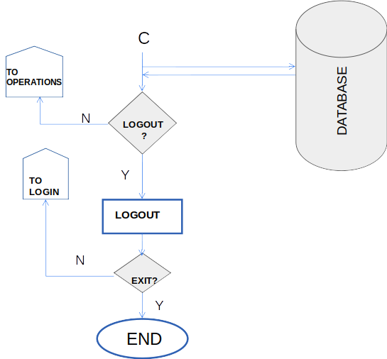
C

